Slide 1
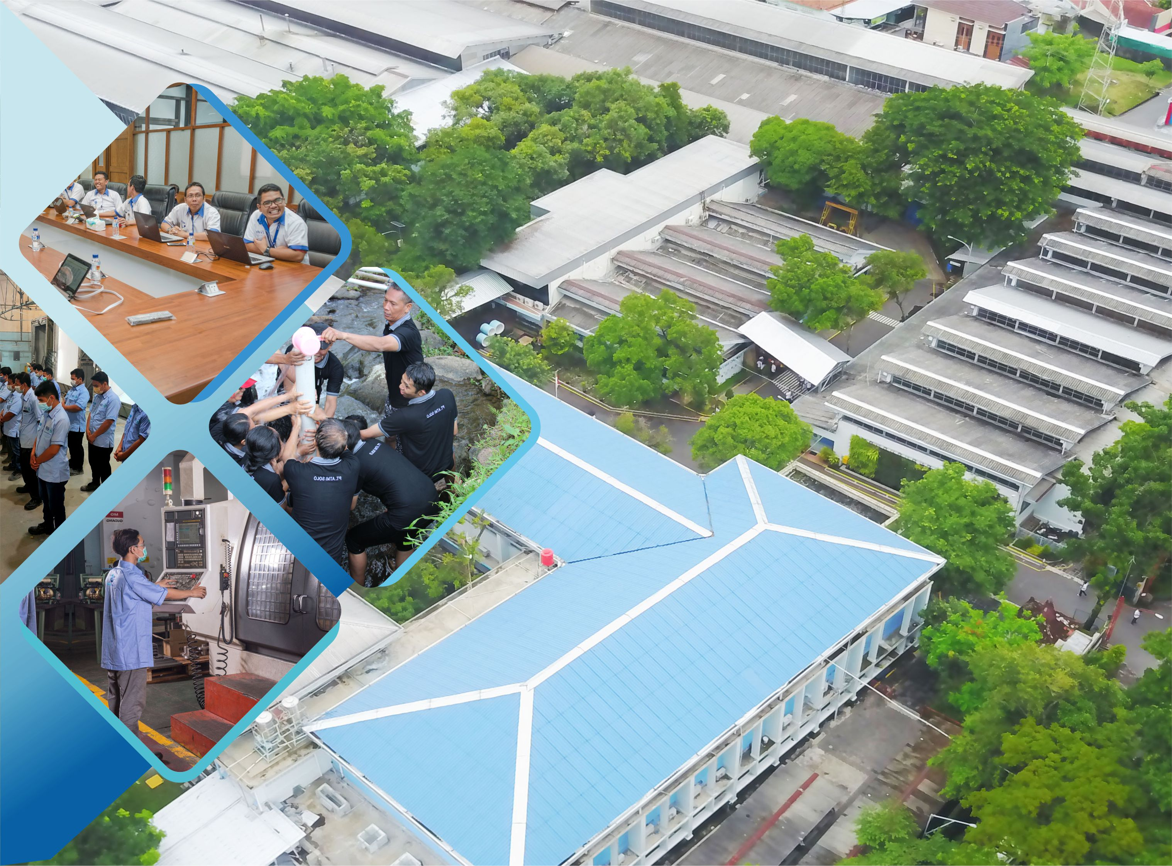


WELCOME

Slide 2
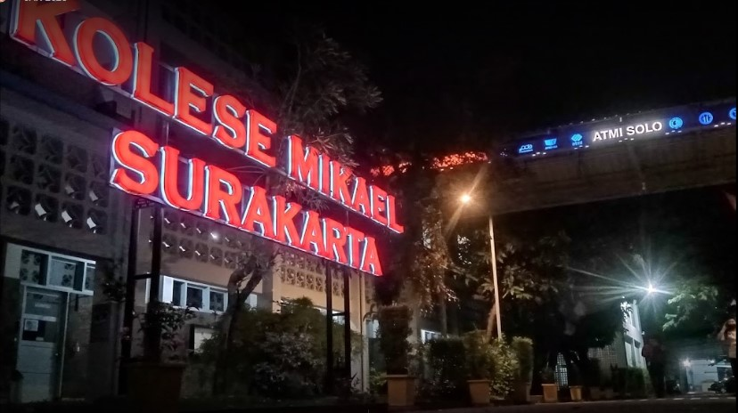

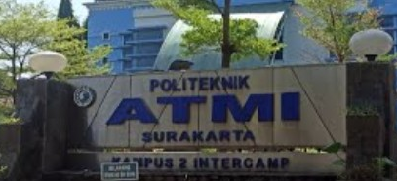
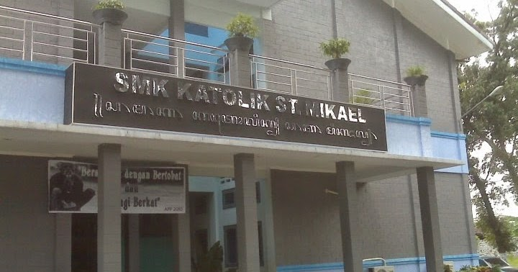
ATMI GROUP
@2024

Slide 3
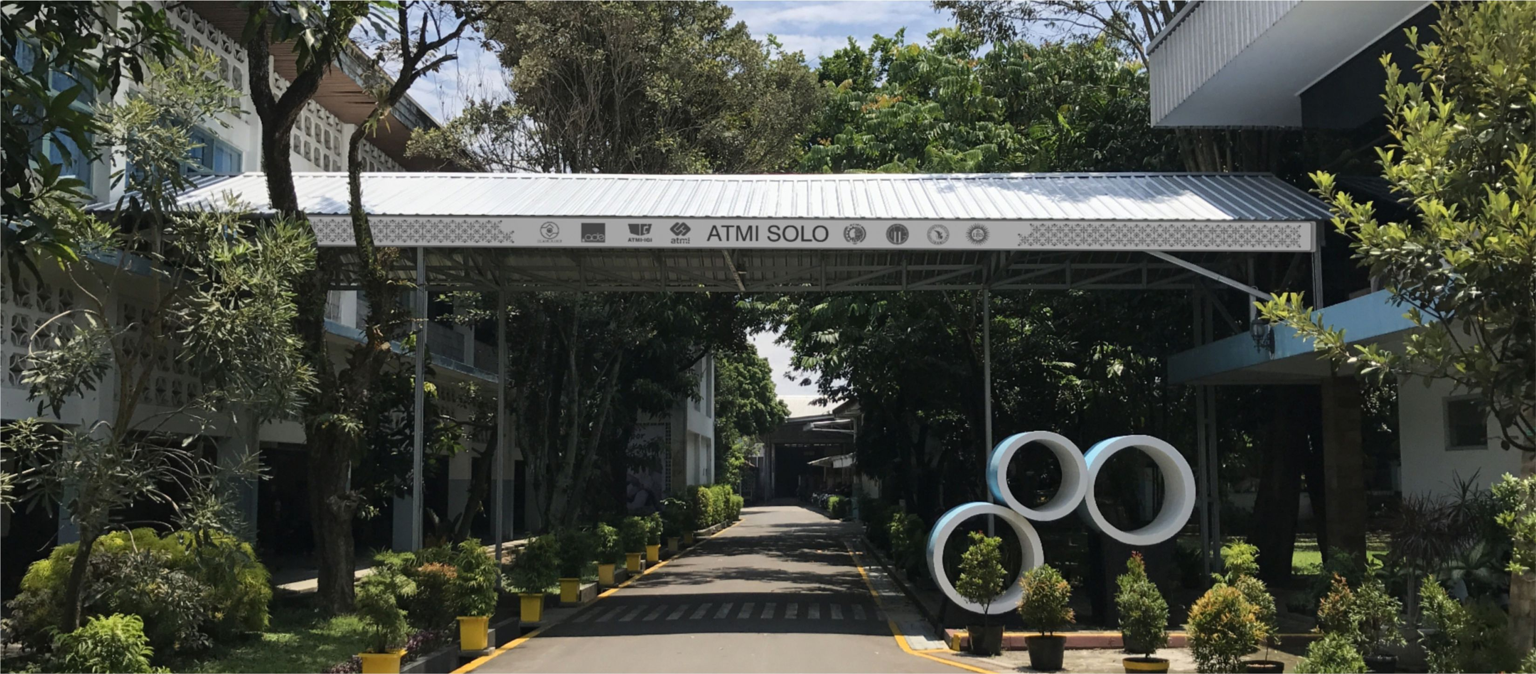
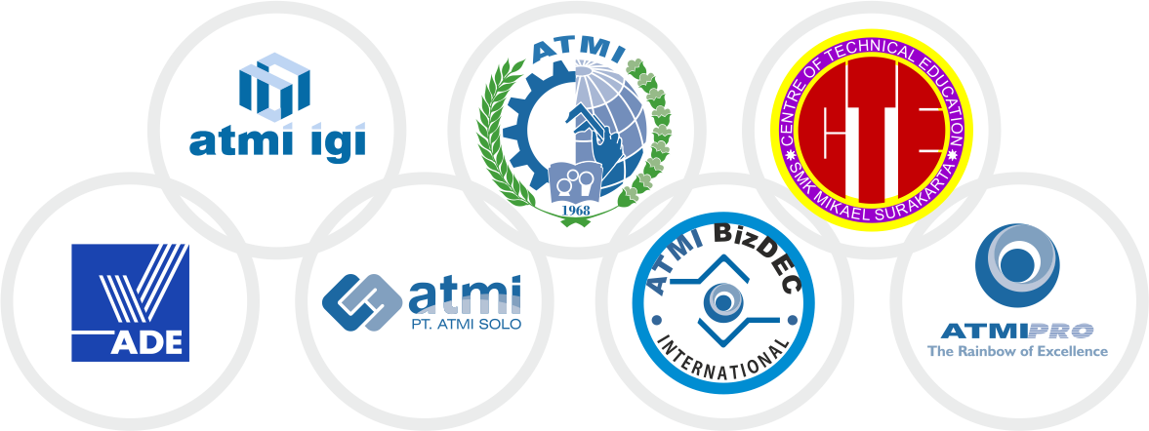
YAYASAN KARYA BAKTI SURAKARTA
www.atmi.ac.id
www.smkmikael.sch.id
www.atmi.co.id
www.atmi-igi.co.id
www.ade.co.id
www.atmibizdec.id

Slide 4
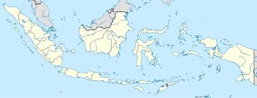
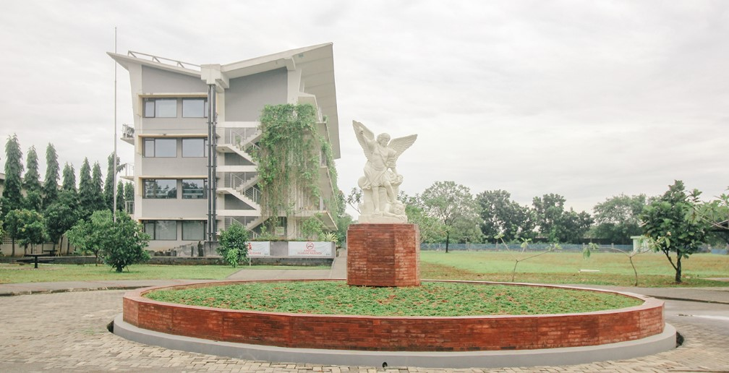
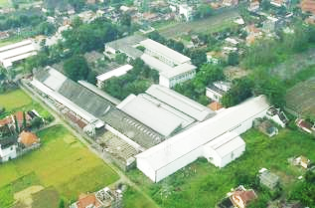
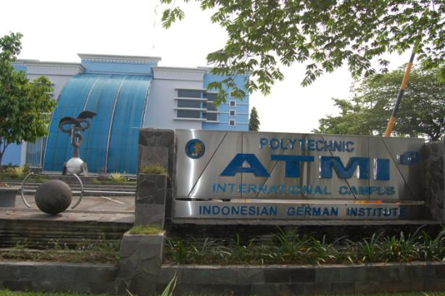
Introduction
singapore
jakarta
cikarang
ATMI Cikarang
44.000 m2 (Start 2003)
2nd Location: West Java
surakarta
ATMI Surakarta & SMK Mikael
31.000 m2 (Start 1968) 45.000 m2 (Start 2005)
1st Locations, Central Java
ATMI Cikarang, start 2003 – Manufacturing & Mechatronic – 250 Students
PT ATMI Cikarang – Production, Mold & Dies, Stamping, SPM
Politeknik ATMI Surakarta, Start 1968 – Manufacturing, Design & Mechatronic – 540 Students
SMK Mikael (Vocational High School) – 480 Students
PT ATMI Solo – Sheet Metal, SPM, Mold and Dies, Plastic, Mechatronic
ATMI is a success model of vocational education in Indonesia using Production Based Education and Training approach (Dual System – acc to Germany / Swiss)

Slide 5
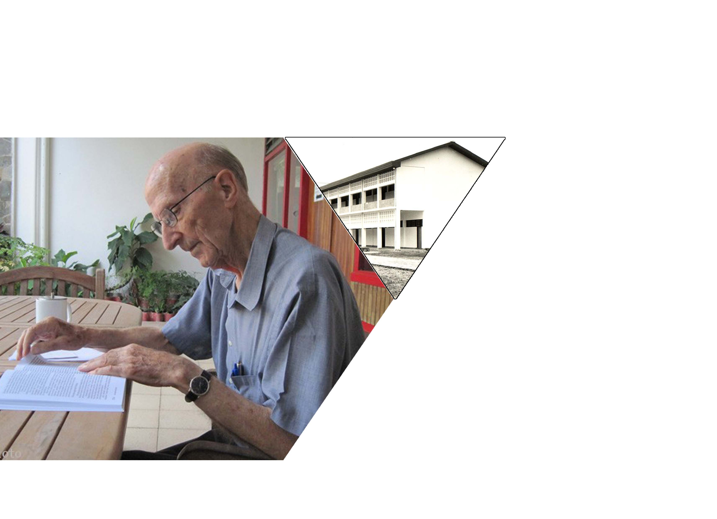
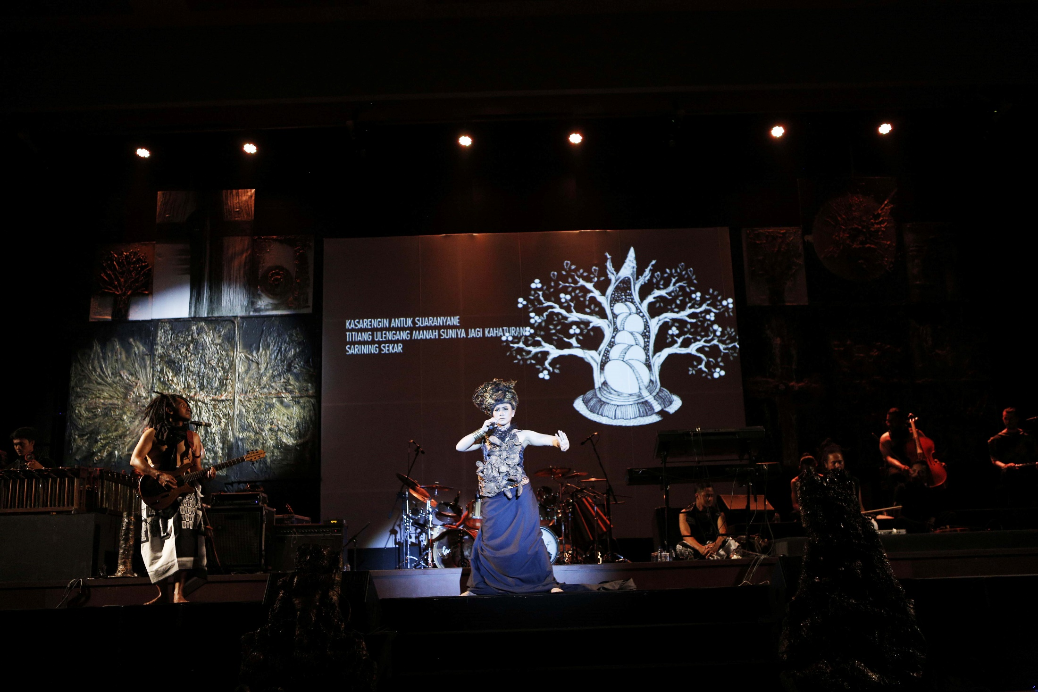
J. Casutt SJ
VISION
To create a fair and high standard industry, which respects the human dignity and environment.
MISSION
To train and educate young people becoming professional engineers with moral and social responsibilities according to the 3C:
COMPETENCE
(technical)
CONSCIENCE (moral attitude)
COMPASSION
(social respect)
COMMITMENT
(responsibility)
Focus : educate young people to have “4C”

Slide 6
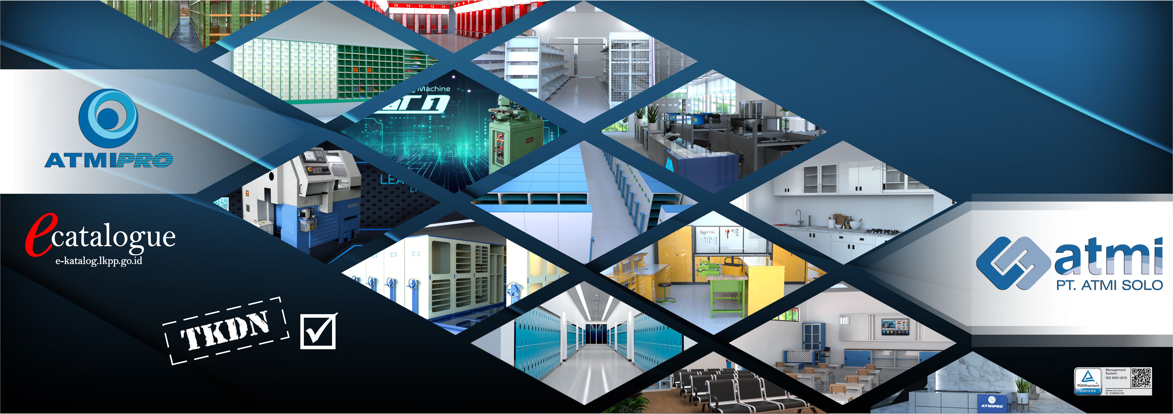
ATMI Milestones
2019 – Strengthening Roles for Indonesia
2018 – ATMI 50th
2017 – New Study Field (4 years)
Revitalization – 2010-2016
Industry 4.0
Machine Tool builder
Mold and Dies
Government Acknowledgement
Launching ATMI Story
Capacity Up 234 Students in 5 Study Fields
Fulfill Industry Needs
Capacity Up
Machineries Investment
Networking with Government
2007 - Co Founder SOLO Technopark
Initiator for Solo Technopark
Best Case within IGI Alliance
2003 – Build ATMI Cikarang
Founded by Alumnus and Partner Industries
Field : manufacturing and Mechatronic
2006 – Solo New Campus
Build 2nd Campus
Open Mechatronic and Design Study Fields
Capacity Up : 180 Students / year
1962 - SMK Mikael is founded
1968 - ATMI establishment
1975 - Start Teaching Industries (Company)
1986-2006 Capacity Up
Founded by Holland Jesuits
CTE – Center of Technical Education
Founded by Swiss Jesuits, 25 students / year
Field : Manufacturing
1975 – Sheet Metal
1986 – Tool Making
2007 : ATMI IGI Company
2013 : ATMI Solo Company
2014 : ADE Company
Step by Steps adding Seats and Machineries
24-54-72-108-180 Students / year

Slide 7
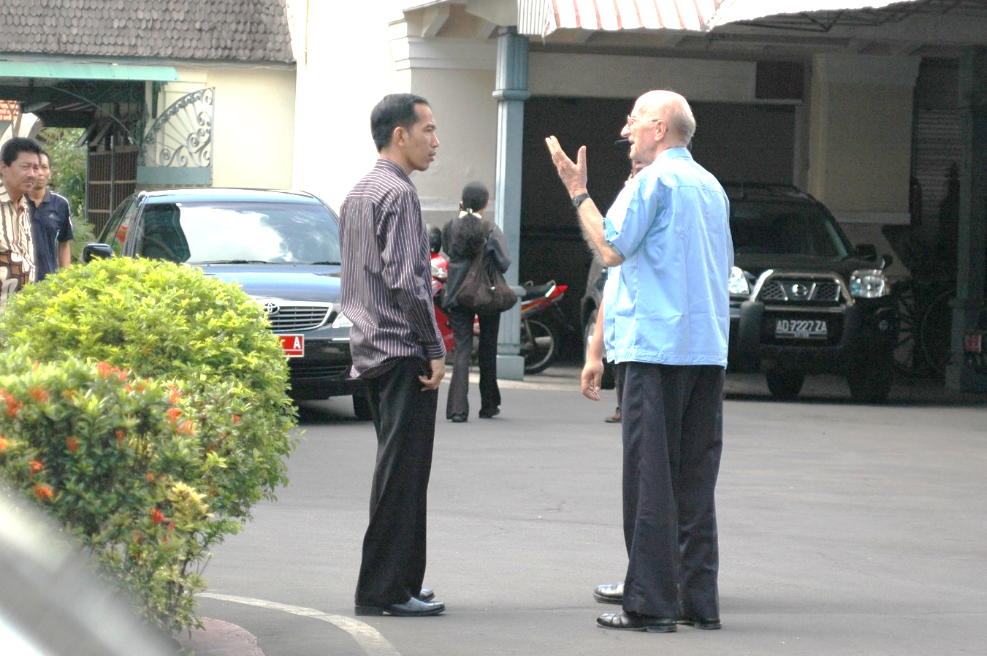
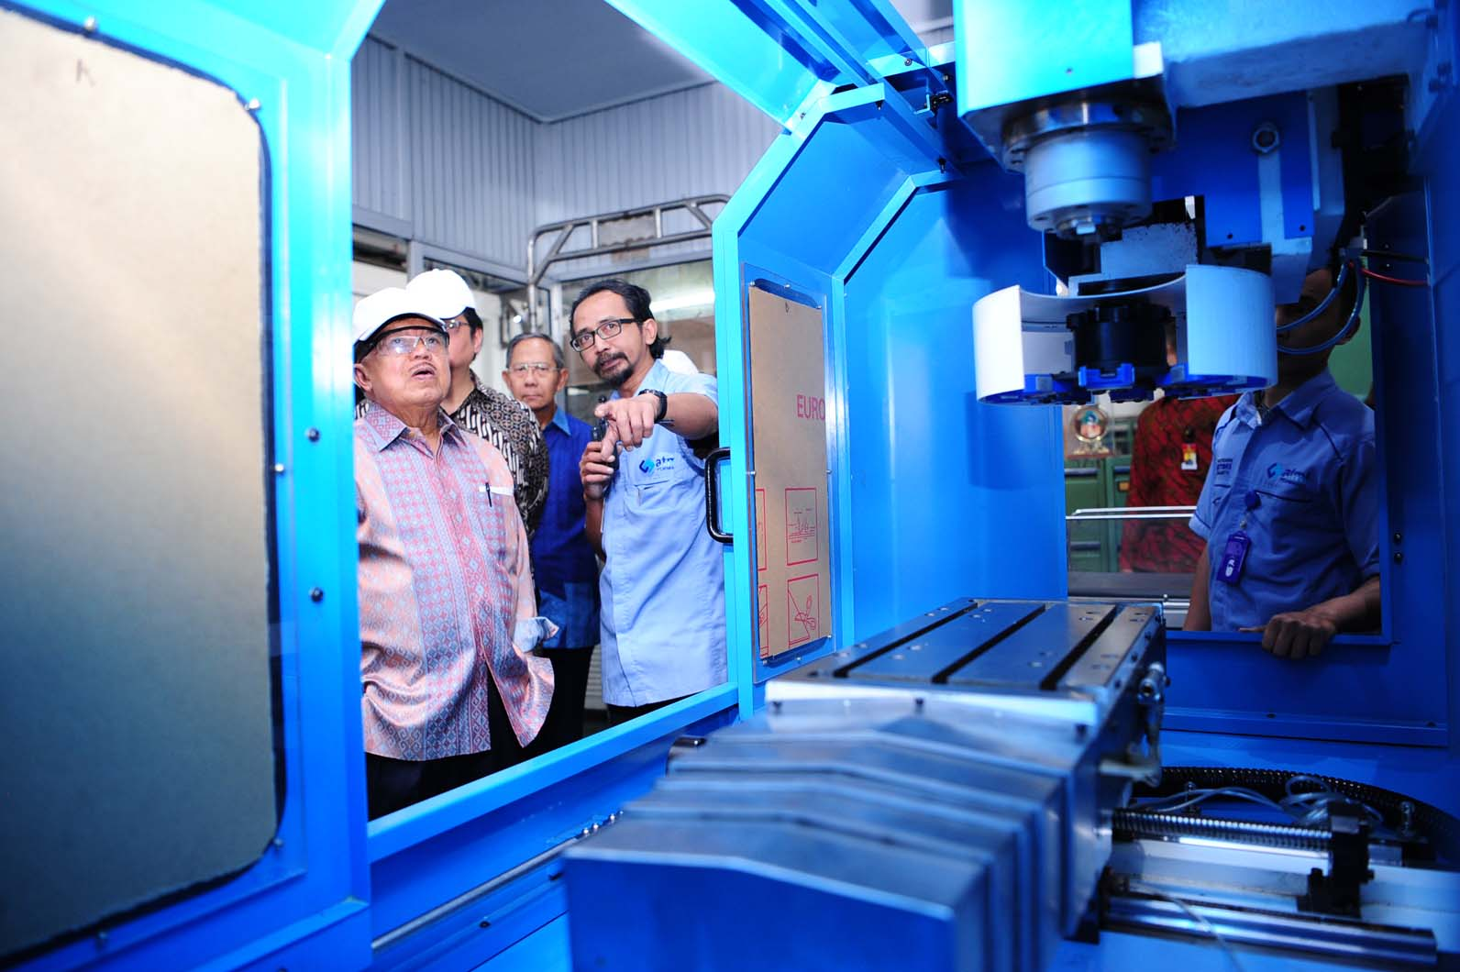
Highlights about ATMI
1. ATMI was founded by the Society of Jesus. Initially it was run by the Jesuits from Switzerland
2. A first vocational academy / polytechnic in Indonesia that runs Production Based Education and Training (PBET) System
4. Become an asset of the nation due to the continuous contributions to the indonesian industries
3. Now becomes a model for manufacturing polytecnic in Indonesia (the government established around 20 new Polytechnics based on ATMI’s model)

Slide 8
ATMI Vision 2030 (2021-2030)
Innovation
Smart Stylish Furniture
Special Machines &
Precision Parts
Medical Technology
Smart Lab
Automation / Handling System
Applied Technology
Quality of Life Improvement Products
High End Mold and Dies
High Tech Development
Production Base
HIGH VALUE MANUFACTURING
(MDC, WF, MTP)
SMART
MECHATRONIC
(MEC, MDC)
INTEGRATED ENGINEERING SOLUTION
(MEC, MDC, Eng, MTP)
PLASTIC PROCESS-ING and MOLD- TOOLS CENTER
(MTP, WI)
SPM
Energy Product
Process Optimation
Mold and Dies
Precision Parts
Medical Technology
Engineering and RnD
Stamping and Plastic
Sheet Metal Standard P
CNC Technology
Tools and Part Design
Product Development
Sheet Metal Projects
Mechatronic Products
Training Center
MANUFACTURE
(TMI, RnD, LPPM, TC)
MECHATRONICS
(TMK, RnD, LPPM, TC)
DESIGN ENGINEERING
(TPM, RnD, LPPM, TC)
PLASTIC PROCESSING CENTER (IGI, TPM, TC)
Education &
Training
TECHNICAL EDUCATION
(Government Institution, International Network)
INDUSTRIES
(Alumny, Partners)
SOCIETY
Vocational Schools
Suppliers
Cooperation
Networking
Higher Education
Non formal technical Education
CSR
Competen- cy Standar-dization
Professional Association
Community
Technolo-gy Centers
Alumni
Villages, Solo City
Influence

Slide 9







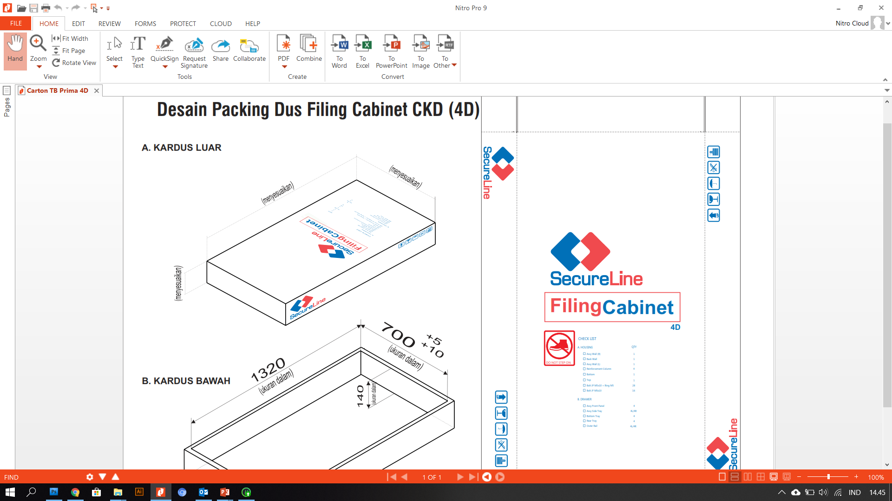















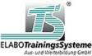

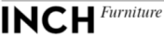





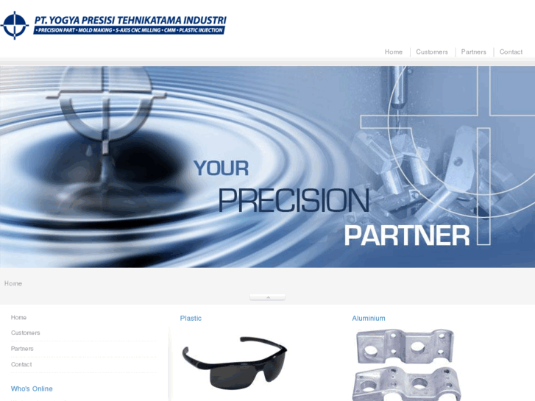

Networking & Cooperation
Partners, Alumni Users, Customers, Experts
U
C
C
etc ..
ATMI is open to any win-win collaboration, the ultimate aim is Vocational Education Development, Sustainable Industrial and economic Development.
International Touch is highly demanded

Slide 10
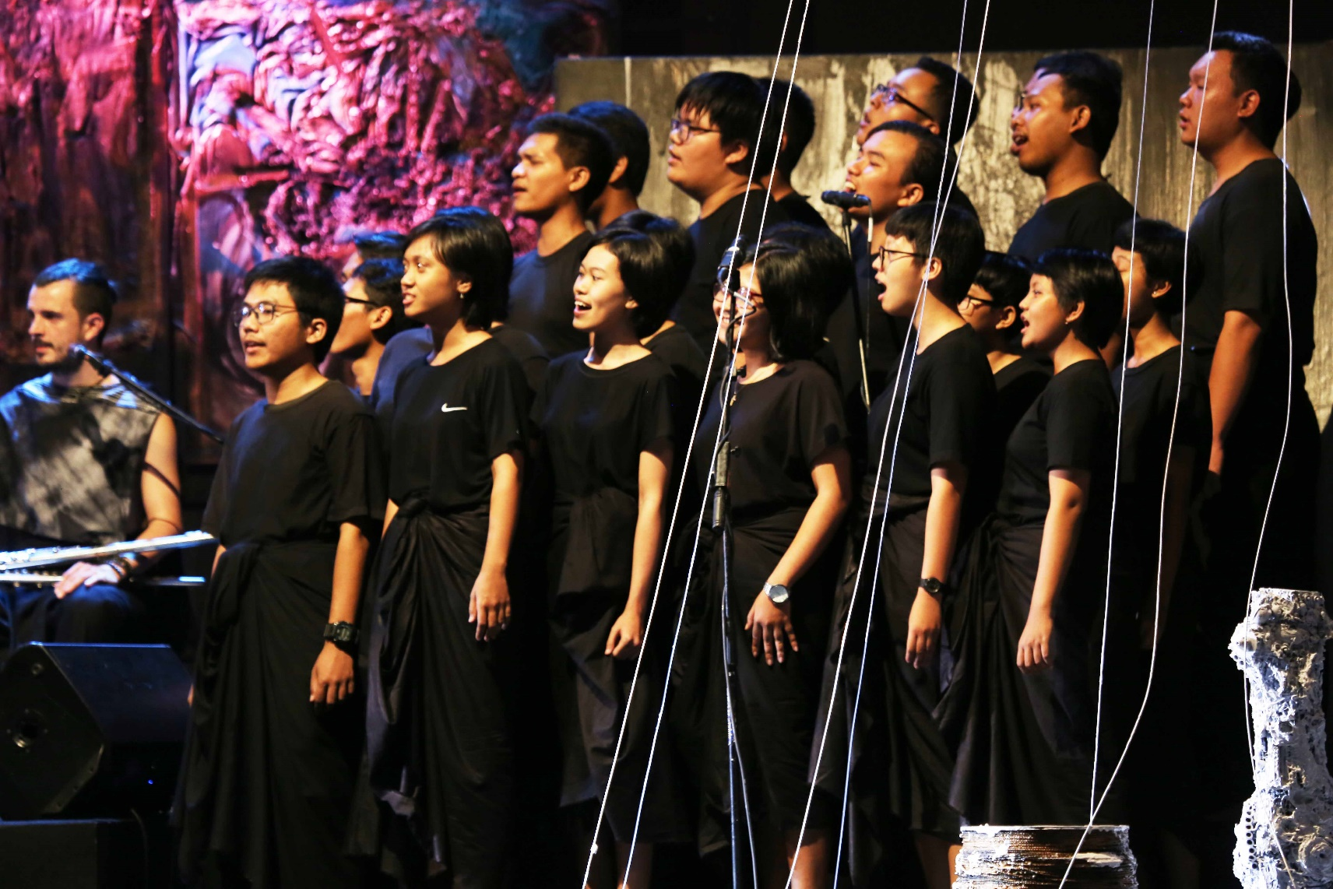
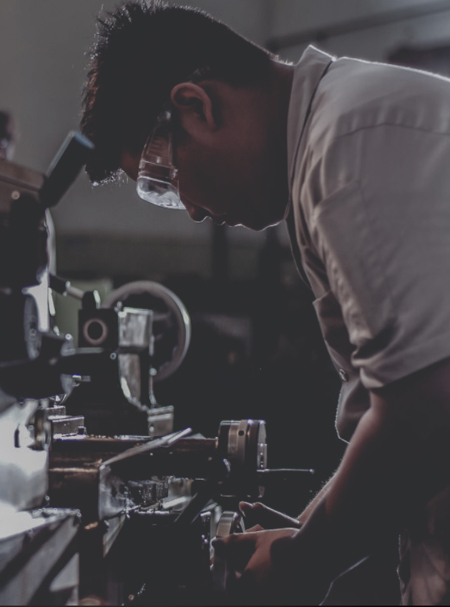
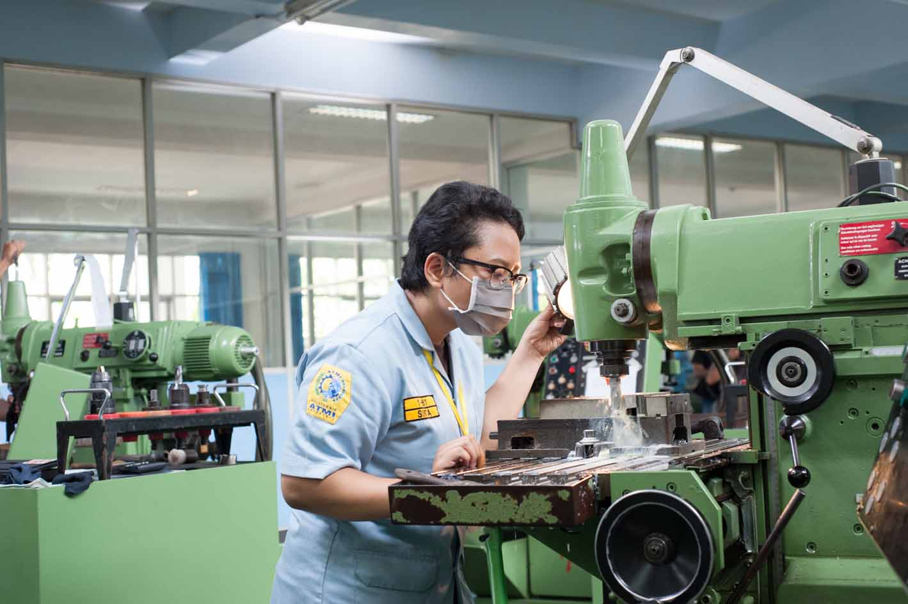
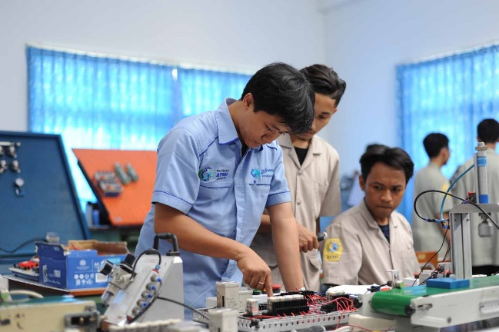
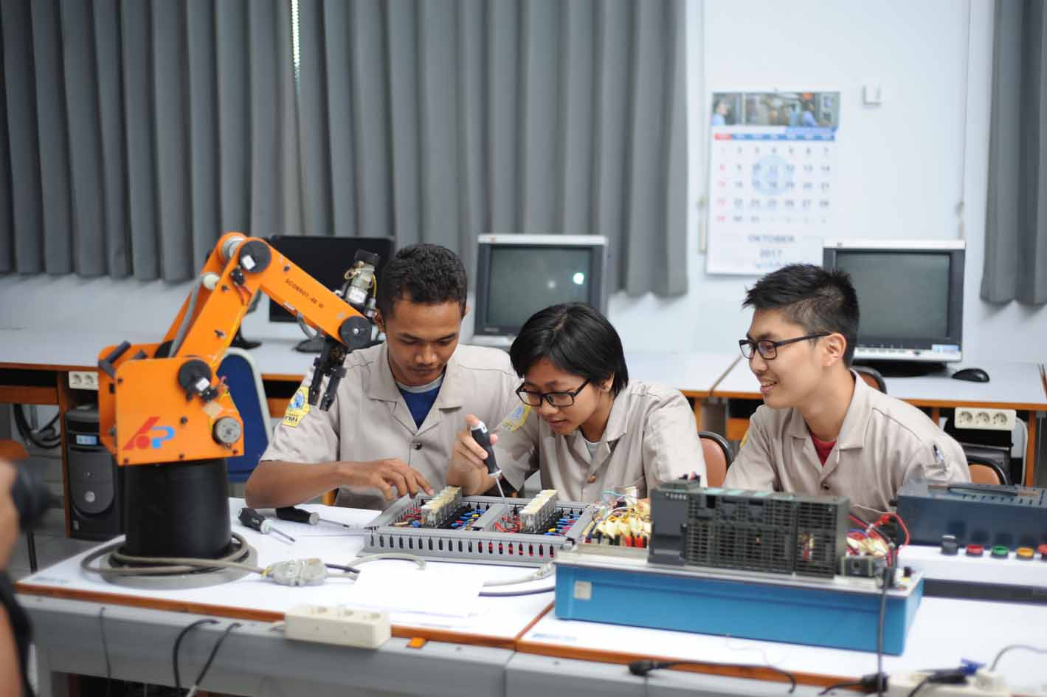
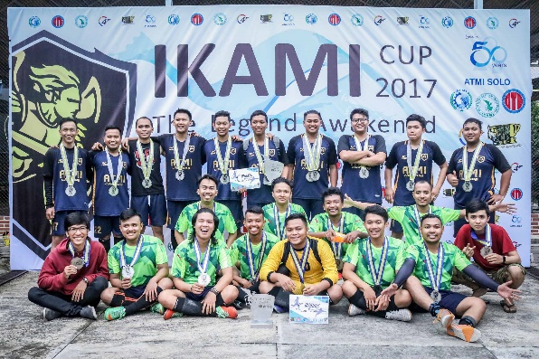
Education Activities
PBET – Dual System (focused on Practical Training – 67%) is consistently implemented, Character building is additional point
Female students is around 12% and the needs is growing ..

Slide 11
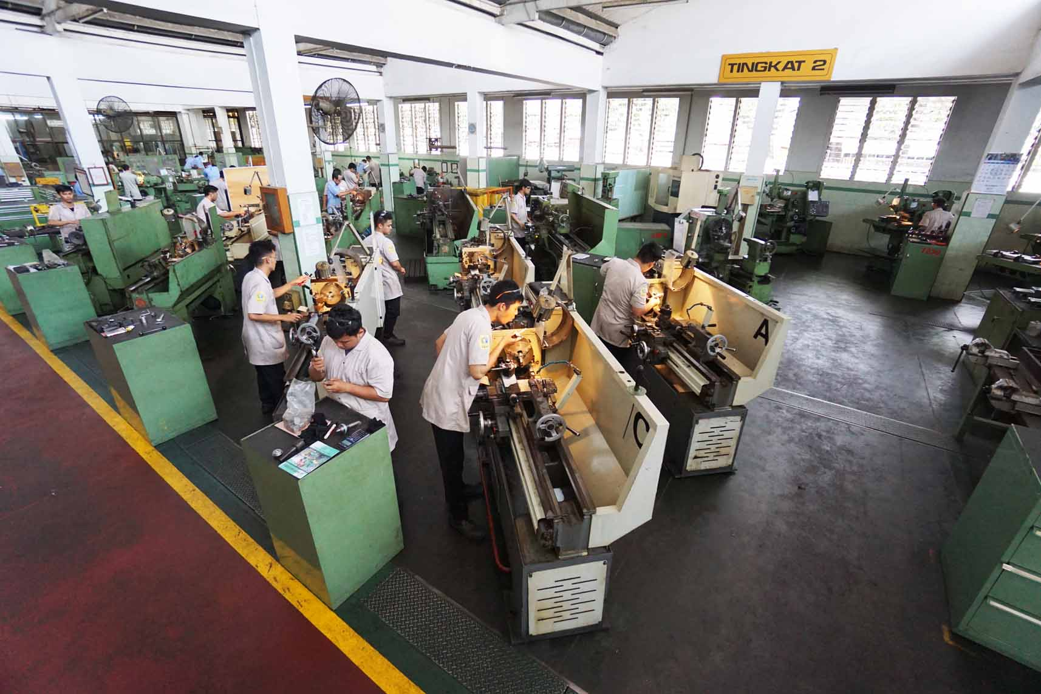
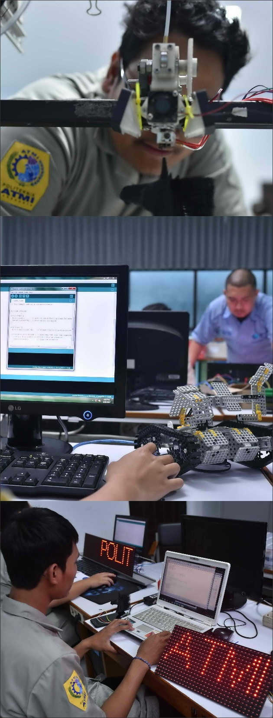
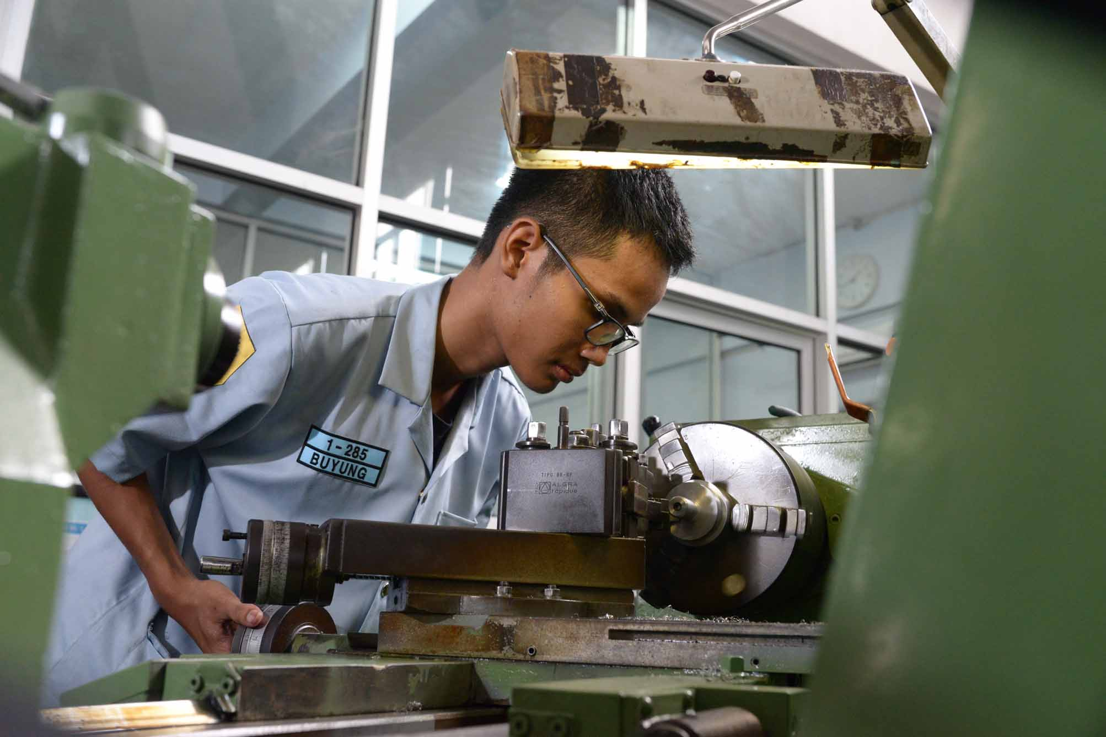
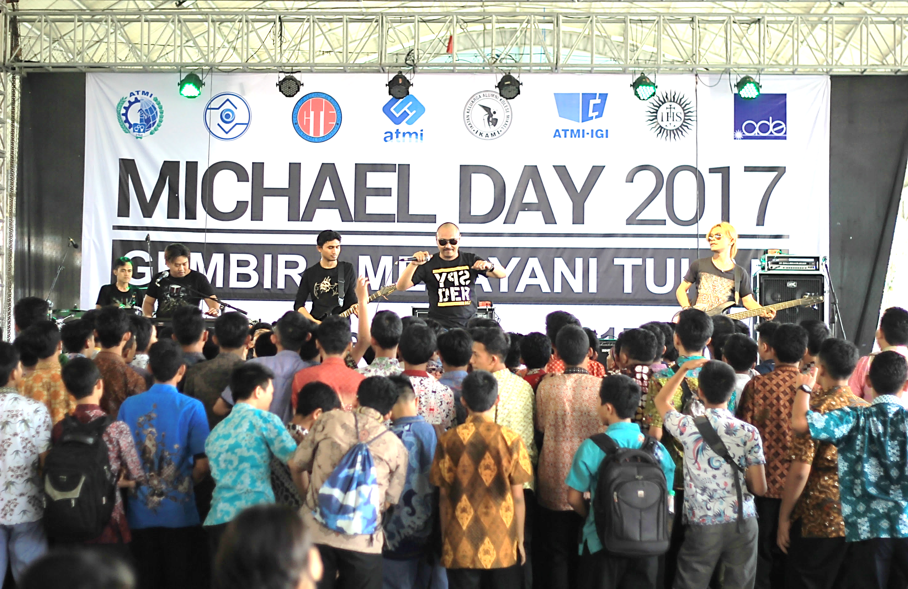
Education Activities
Design Lab Activities
1st year Workshop
Michael Day
Production Workshop

Slide 12
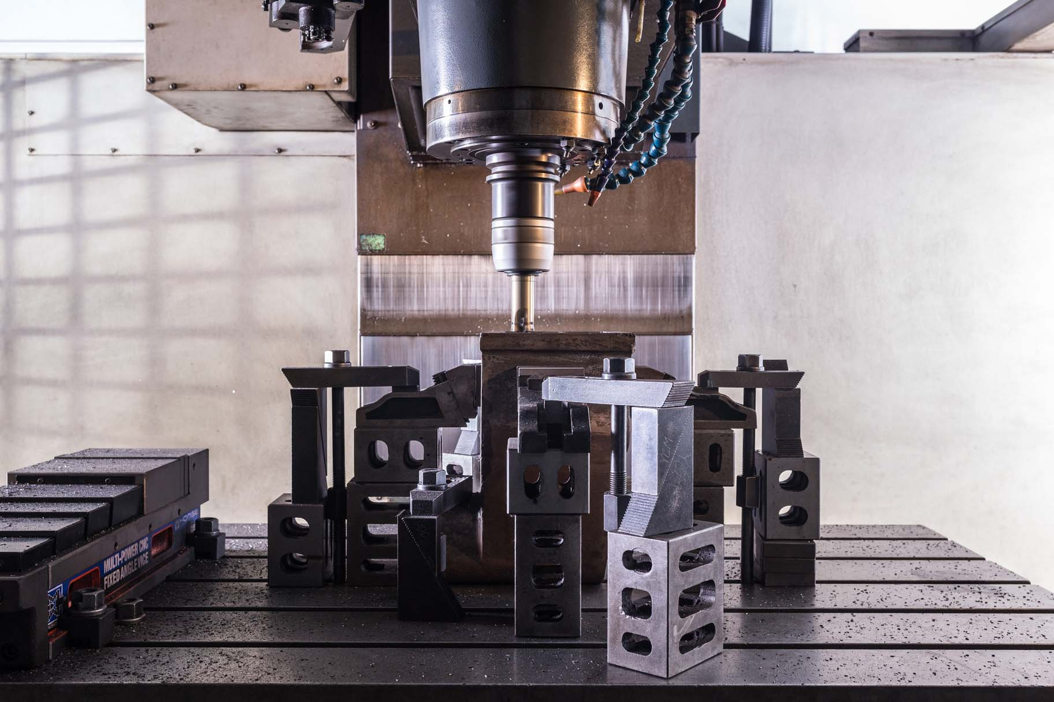
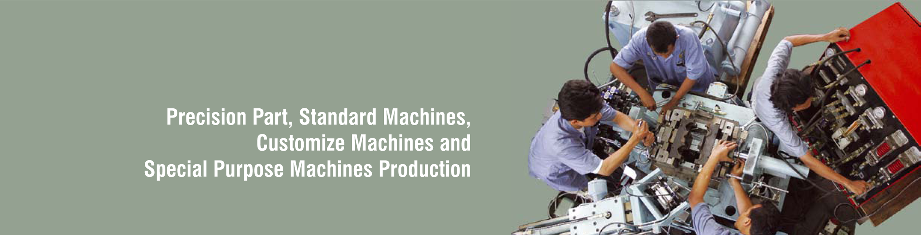
.
Is a unit PT ATMI which is the development of Work Mechanic Unit.
MDC handles the development, manufacturing and servicing machines both standard
machines, special machines and customize machine ordered by customers.
MACHINE DEVELOPMENT CENTER

Slide 13
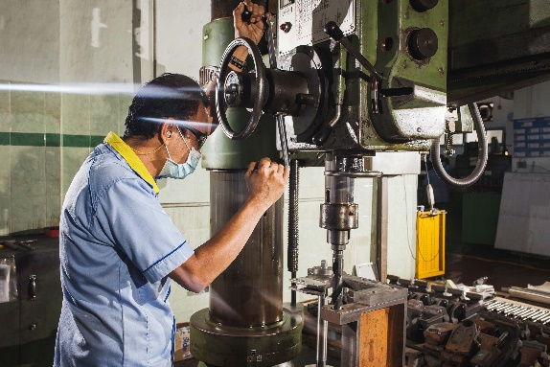
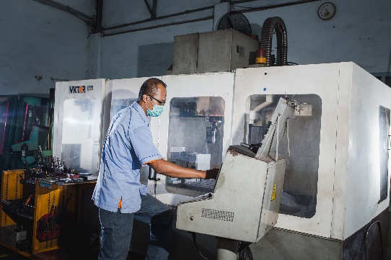
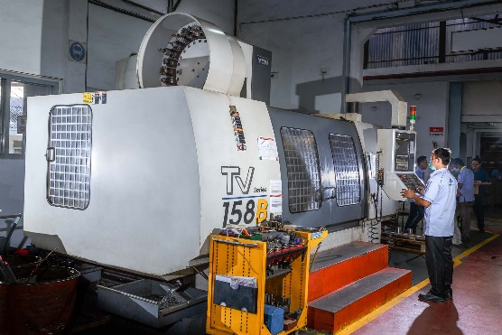
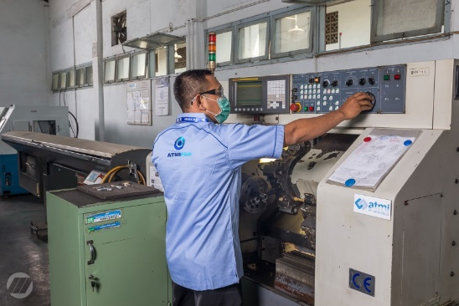
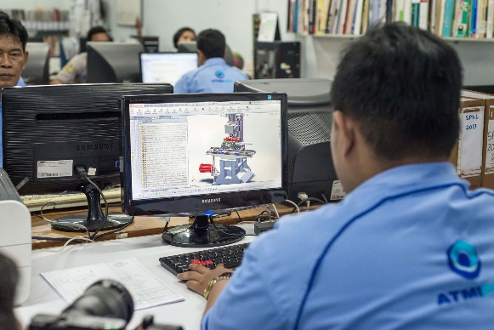
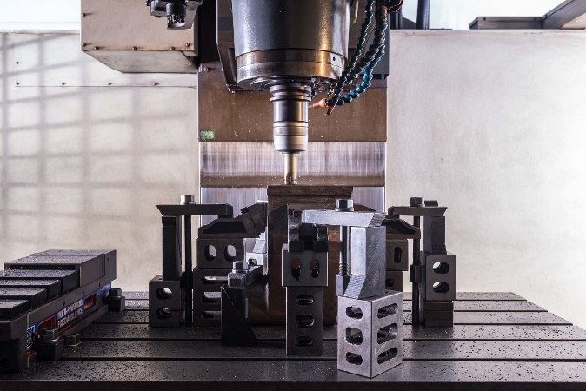
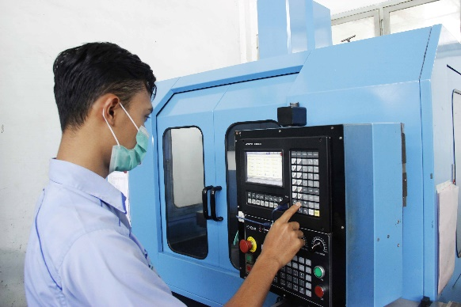
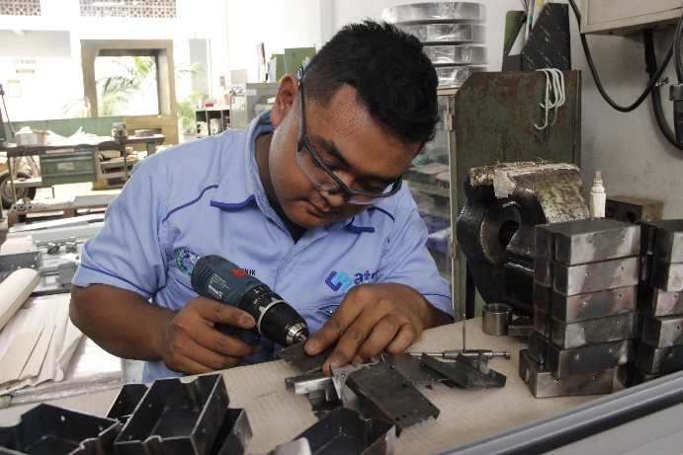
CAPACITY OF MACHINE DEVELOPMENT CENTER
Unit helps students to learn the most updated demand on complexity and automation technology.

Slide 14
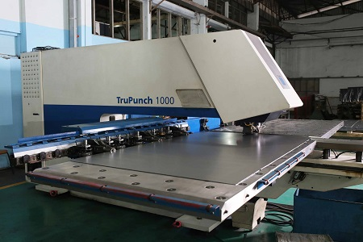
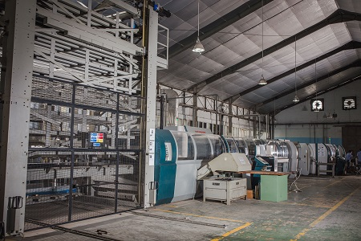
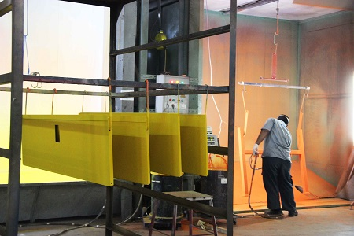
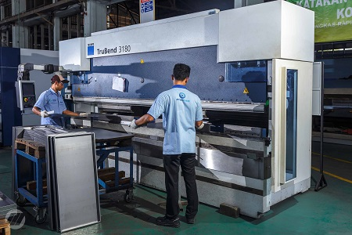
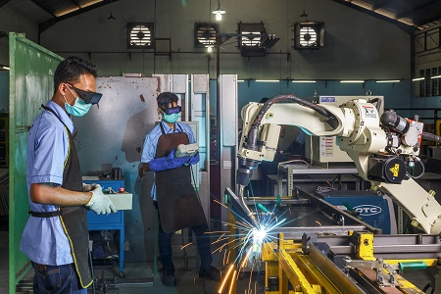
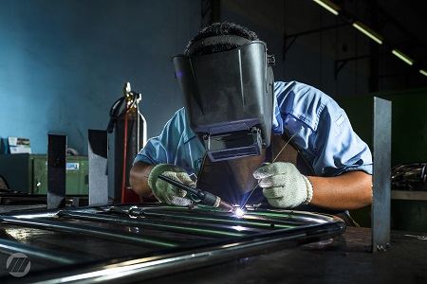
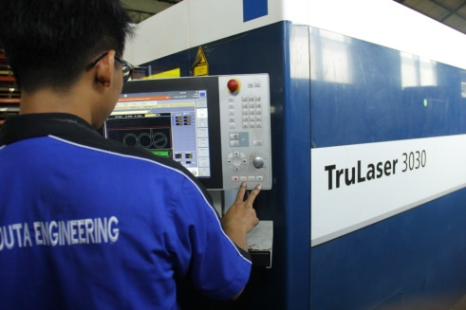
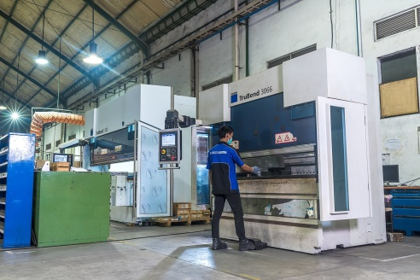
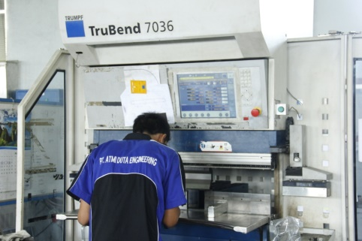
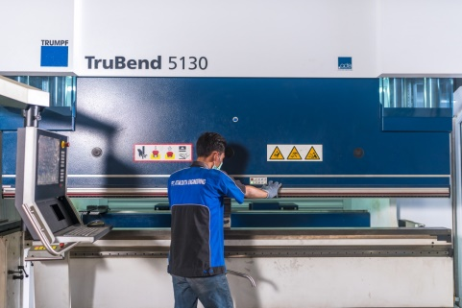
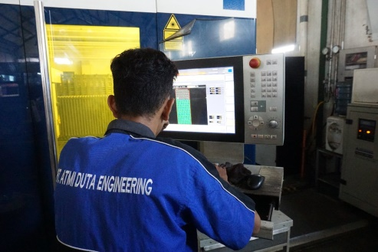

ATMI Machineries – Sheet Metal, Laser Cutting
Trumpf TCR 1000
Panel Bender Salvagnini S4-P4
Powder Coating - Oven
Tru Bend 3180
Robot Welding
Various Manual Welding
Tumpf Laser Cutting 3030
Tru Bend 3066
Tru Bend 7036
Tru Bend 5130
Tru Punch 200
Trumpf Laser Cutting 3040

Slide 15













ATMI Machineries – Mold Making, Plastic Injection, Product Development
Wire Cut (AGIE Charmilles, Fanuc)
EDM (AGIE Charmilles, Makino)
CNC Milling – 5 axis (DMG Mori)
Milling CNC 1500 x 800 (YCM, Makino)
High Speed Stamping, Haulick 50T
Plastic Injection : Toshiba Japan – 75T, 80T, 100T, 180T, Arburg 80T, 130T, Kawaguci 140T, JSW 150T
3D Scanning
3D Printing
Density Testing
MFI Testing
Environmental Testing

Slide 16







Special Purpose Machine (SPM)
Print Ability Tester | Customized Washing Machine | Grinding Machine | CNC Edu Mill
CNC Edu Lathe | Jam Mixer Mchine | Speciallity Table | Washing Machine 35 Kg

Slide 17






Precision Parts Product
Automation Equipments, and Spare Parts

Slide 18




Precision Parts Product
Automation Equipments, and Spare Parts

Slide 19




Precision Parts Product
Automation Equipments, and Spare Parts

Slide 20



Precision Parts Product

Slide 21








Precision Parts Product
Automation equipments, and Spare Parts

Slide 22

Standard Product
Office and School Furniture
Knowing the importance of proper office equipment to the success of an education or business enterprise, PT ATMI SOLO produces office and school equipment,such as office desks, multifunction chairs, student desks and chairs, filing cabinet, etc.

Slide 23

Office Furniture

Slide 24











Office and School Furniture
Mobile File | Ordner Rack | Book Shelves w/ Sliding Door | Practice Table
Waiting chair | Writing Desk Special | Speciallity Table | Sliding Cabinet
Meeting Table | Drawing Table | Multipurpose Chair | Typist Chair

Slide 25

Office Furniture

Slide 26



Laboratorium Furniture

Slide 27




Laboratorium Furniture

Slide 28

Laboratorium Furniture

Slide 29




Laboratorium Furniture

Slide 30

Workshop Equipment

Slide 31










Workshop Equipment
Machine Tool Cabinet | Machine Tool Cabinet | Drawer Cabinet | Small Tool Cupboard | Small Tool Cart
Rack 6 Compartment | Rack 3 Compartment | Workbench Type EC | Workbench one Pedestal | Workbench 2 Drawer

Slide 32


Hospital Equipment

Slide 33






Hospital Equipment

Slide 34








Medical Equipment

Slide 35




Medical Equipment

Slide 36







Facilities and Equipment in mould & dies processing
Wire Cut (Charmilles, Fanuc)
EDM (Charmilles, Makino)
CNC Milling – 5 axis (DMG Mori)
Milling CNC 1500 x 800 (YCM, Makino)
CMM (Mitutoyo)
CNC Milling (Okuma, Moriseiki, YCM)
High Speed Stamping
Milling CNC 600 x 400 (Mori Seiki)

Slide 37


Mould & Dies Processing

Slide 38

Mould & Dies Processing

Slide 39


Mould & Dies Processing

Slide 40






Customize Sheet Metal

Slide 41

















ATMI Products
Precision Part
Special Purposed Machine
CNC Machine
Production Line
Customized Product
Workshop Equipment
School Equipment
Hospital Equipment
Sheet Metal Project
Laser Cutting Project
Plastic Injection Mold
Aluminium Die Casting
Jig and Checking Fixture
Metal Stamping Dies
Stamping Parts
Engineering - Simulation
Product Development
Prototyping – Reverse Eng
Material Testing
Plastic Injection Parts
Real Projects are done by Companies (Teaching Industry), in Alignment with Polytechnics in order to give the maximum Benefit for the Students. Customers and Partners gain double benefits in Products and Human Resources (future employee).

Slide 42








Current and Future Development
Capacity Up from internal resources
2015 : Design and Study Fields 36x2 to 54x2 students
2017 : Adding 36x2 students in Diploma 4 Program
2017 : Open Remote Program in Maumere
Government – Industry Strategic Program
Plastic Center – Ministry of Education / - Industry
Local Machine Tool Builder – MoI
Local Mold Maker – MoI & Mold Association
Founder of Association of Polytechnic and Industry Indonesia (APII) – Align with Swiss Friends
Strengthen the Education align with Industry Development
Industry 4.0
3D Printing
Robotic
Industrial Automation
Plastic Technology
Training the Trainer to catch up the Industrial Trend
Automation
Machine Tool Builder
Robotic
Handling System
Engineering
Mold and Dies
Rapid Product Development

Slide 43






Closing – The Challenge of Industrial Collaboration with ATMI
Challenge for Industrial Collaboration
ATMI is willing to learn, fight and collaborate with Industries for the development of vocational education in Indonesia
More industrial- and government support is needed to strengthen and accelerate the development
Opportunity
Win-Win-Win Collaboration in Developing the Vocational Education
With the number of alumnus working in various strategic industries in Indonesia, co-investment is a strategic middle-long term marketing strategy
Branding and Transfer Knowhow with the biggest impacts
Needed Support from Partners
Regulation which is Pro vocational education
Co-Investment
Corporate Social Responsibility Program
Industrial Projects Initiators
Technology Transfer
Internship – Training for Trainer
Start Localization Programm
Thank you – Herzlichen Dank – Terimakasih - Maturnuwun

Slide 44


“If you want to change the world, educate youth….”
St. Petrus Canisius

